Slide 1
Comparative Analysis of Machine Learning and Deep Learning Models for Question Pair Similarity Assessment
Presented By:
Himanshu Shekhar

Slide 2

Introduction
Imagine a world where computers understand questions like humans. Today, we delve into that world as we explore the challenges and solutions in identifying duplicate questions on Quora.
Quora is a popular online platform that facilitates the asking and answering of questions on a wide range of topics, connecting users with knowledge and expertise from around the world.

Slide 3
Importance of Question Pairs
"Why do question pairs matter?“
Enable chatbots to answer diverse queries.
Refine search engines.
Power recommendation systems.
"The challenge lies in detecting duplicates, even when the questions are subtly different."

Slide 4

Problem Statement
The task at hand involves discerning whether two questions are duplicates or convey the same meaning.
How can I make homemade pizza dough?
What is the recipe for preparing pizza dough from scratch?"
How can I make homemade pizza dough?
What is the recipe for preparing pizza dough from scratch?"
Are they same?
What are some effective study techniques for improving memory?
What are the best methods to enhance memory retention while studying?

Slide 5
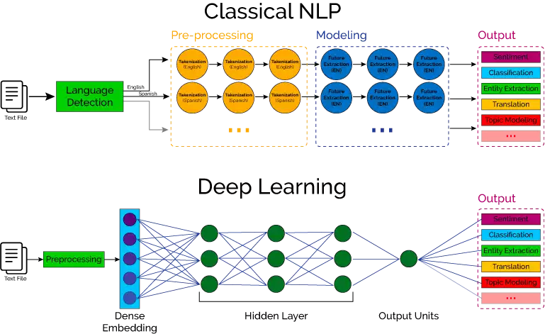
Approaches
Classical ML approaches
Deep Learning approaches
Logistic Regression
Random Forest Classifier
Support Vector Machines (SVM)
Artificial Neural Networks (ANN)
Recurrent Neural Networks (RNN)
Convolutional Neural Networks (CNN)

Slide 6
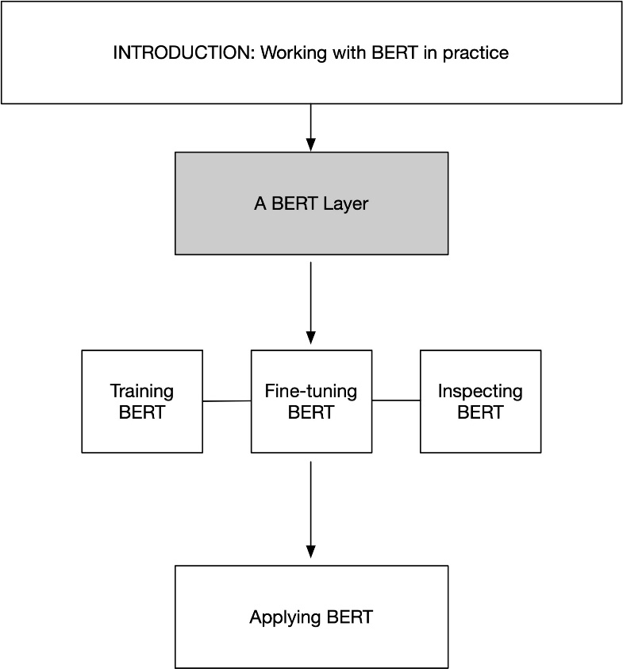
The Transformer Revolution
In recent years, transformers have revolutionized NLP.
"BERT, with its bidirectional nature and attention mechanisms, enhanced contextual understanding."
Challenges with Transformers:
High computational demands and memory requirements.
Efficient implementations are crucial.

Slide 7

Research Objectives and Model Comparison
Our research aims to compare 10 ML models for the Quora Question Pair Challenge.
Logistic Regression
Random Forest Classifier
Decision Tree Classifier
Linear SVC
Gradient Boosting Classifier
AdaBoost Classifier
Artificial Neural Network (ANN)
Convolutional Neural Network (CNN)
RNN Model
Bert Based Classifier
Data was preprocessed to prepare it for modeling.

Slide 8
Results
Our results revealed model accuracies ranging from 58.9% to 88.4%.
The CNN Model demonstrated the highest performance, achieving an accuracy of 88.4%, BERT based Classifier achieved 87.39%, while the Decision Tree Classifier yielded the lowest accuracy, standing at 58.9%.

Slide 9

Insights
Transformers and Deep Learning Models achieved higher accuracy as suggesting that leveraging deep learning and pre-trained contextual embeddings can significantly enhance the accuracy of text-based classification tasks.
While complex models excel in accuracy, the study emphasizes the importance of considering factors beyond performance, such as computational requirements and model complexity.

Slide 10
Applications
Applications Beyond Quora for Evaluating Question Pair Similarity Models
Enabling chatbots to offer context aware replies.
Increasing recommendation systems.
Language translation.
Sentiment analysis.
Legal document analysis.
Healthcare question-answering systems.
Plagiarism Detection.

Slide 11

Future Directions
Incorporating domain-specific embeddings and contextual embeddings, such as ELMo and GPT, may capture nuances in semantics more effectively.
Future research could explore more advanced deep learning architectures, model ensembles, and hyperparameter tuning to further enhance performance.

Slide 12
Conclusion
Deep Learning Models and Transformer based models Outperform Traditional ML Models.
Balancing Model Complexity and Performance.
Broad Applicability of NLP Techniques.

Slide 13
Acknowledgments
"I'd like to express my sincere gratitude to Prof. Colin Johnson for his invaluable guidance and unwavering support throughout this research."

Slide 14
Thank you.

